Slide 1
Shell Script Programming
Instructor: Li Feng
Capital University

Slide 2
Basic Shell Programming
#![path to shell you want to use]
eg. #!/bin/bash: current script should be run by the Bourne Again shell
#: begins a comment
Variables:
Assignment: variablename=5 (no space between)
Usage: $variablename
Reading from the keyboard
read variablename

Slide 3
Basic Shell Programming
Arithmetic operation:
Constant number declaration: declare -r NUM1=6
$(( )): arithmetic expansion (not for use with an enclosed equal sign)
(( )): arithmetic evaluation (use when the enclosed value contains an equal sign)

Slide 4
Functions
Avoid the need to write duplicate code
Define a function:
Local variable
Global variable
Pass arguments to function: $1, $2, etc

Slide 5
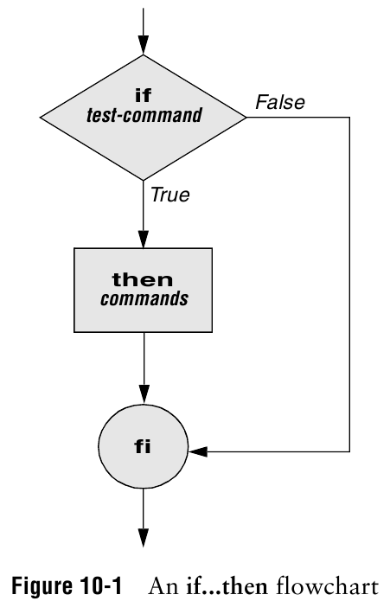
Conditionals
if [ conditional ]
then
fi
Make sure to surround the brackets with spaces (the shell parser requires it)

Slide 6
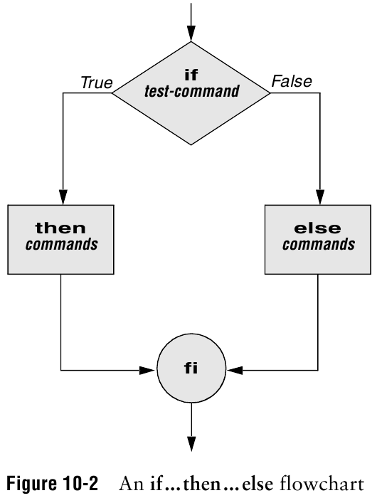
Conditionals
if [ conditional ]
then
else
fi

Slide 7
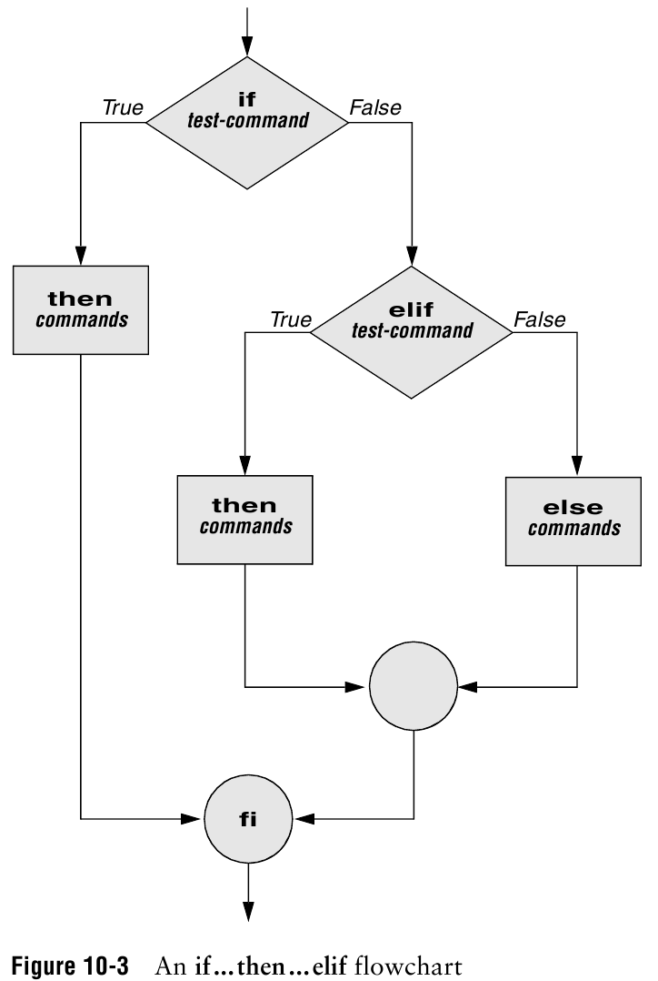
Conditionals
if [ conditional ]
then
elif [ conditional ]
then
else
fi

Slide 8
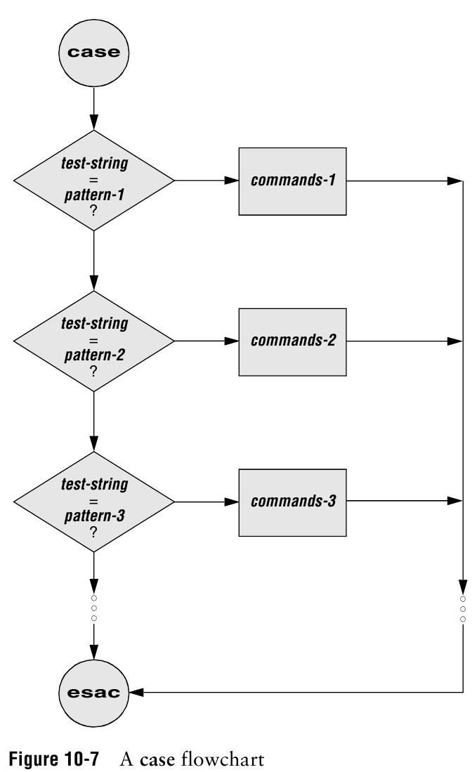
Case Statement
case $variableName in
pattern1)
command
;;
pattern2)
command
;;
*)
command
;;
esac

Slide 9
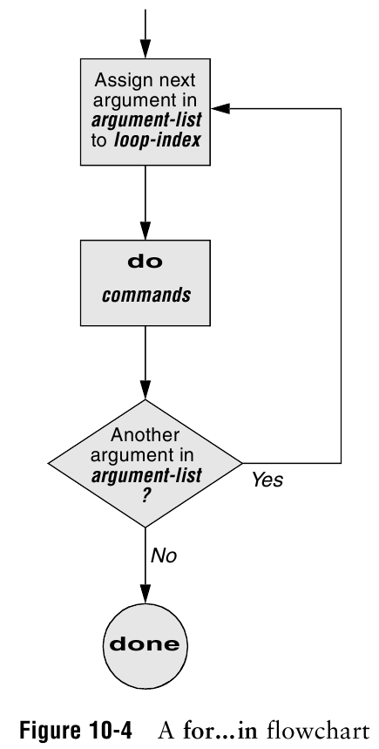
Looping
for (( i=0; i<=10; i=i+1)); do
done

Slide 10
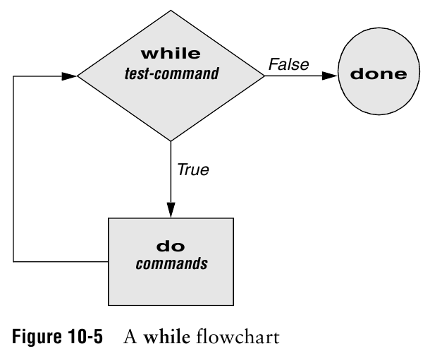
Looping
while [ conditional ]; do
done

Slide 11
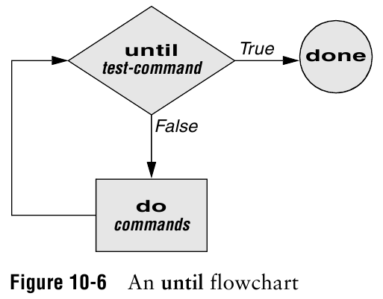
Looping
until [ conditional ]; do
done

Slide 12
Assignment
Lab5 is due next Wednesday (Feb 27th)

